Slide 1
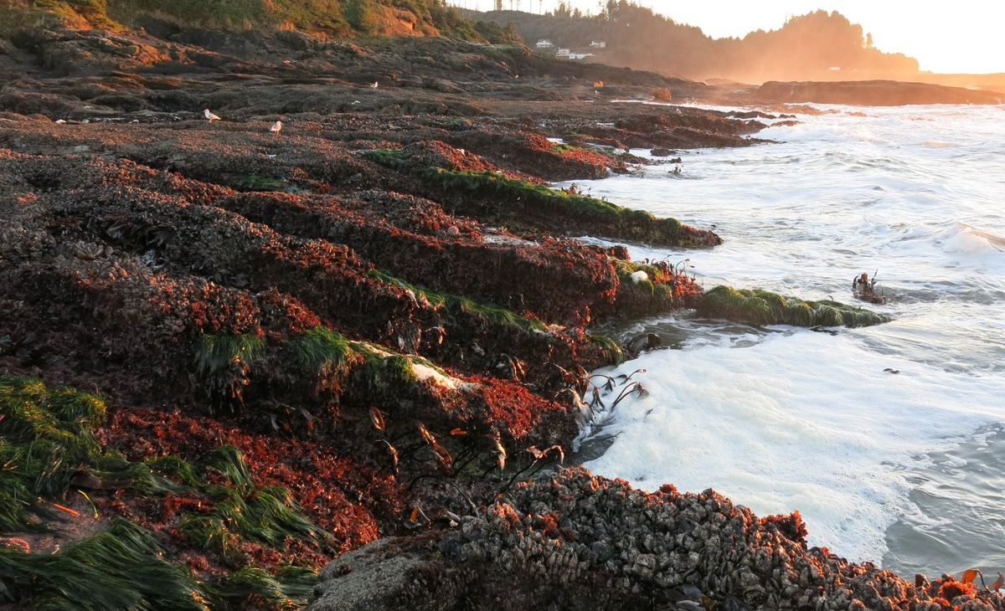
Using Structural Equation Modeling to Investigate Direct and Indirect Effects of Predators in the Rocky Intertidal
Silke Bachhuber
Analytical Workflows
April 10, 2019

Slide 2
Mechanisms of resistance, resilience to SSWS
Pisaster present
Pisaster removed
MID ZONE
MID ZONE
LOW ZONE
LOW ZONE
.
.
.
.
.
.
.
.
.
.
.
.
.
.
.
.
.
.
.
.
.
.
.
.
SEAWARD
SEAWARD
Image by Eric Sanford
Recruitment of mussels and barnacles
Large predators (stars and birds)
Facilitation by algae, barnacles
Small predators
Notes:
SSWS hit, natural experiment to examine strength of keystone species hypothesis
Keystone hypothesis predicts that mussels will move into low zone, but strength seems to be variable in different locations (Bruce 1994 paper at SH, BB)
STARS grant asks a bunch of questions about mechanisms that could prevent incursion of mussels into the low zone
-recruitment of mussels and barns
-large preds (pisaster and birds)
-facilitation
Resilience= pisaster recovery

Slide 3
Can compensatory predation by Nucella ostrina and Leptasterias spp. prevent downward spread of mussels into the low zone?
How does the strength of compensatory predation vary from SoCal to Oregon?
Hypothesis: higher densities of predator species in OR=increased compensatory predation
How do recruitment and colonization dynamics vary from SoCal to Oregon over the course of ~16 months?
Notes:
The first question is the big stars grant one!
Second questions are what I’m focused on--

Slide 4
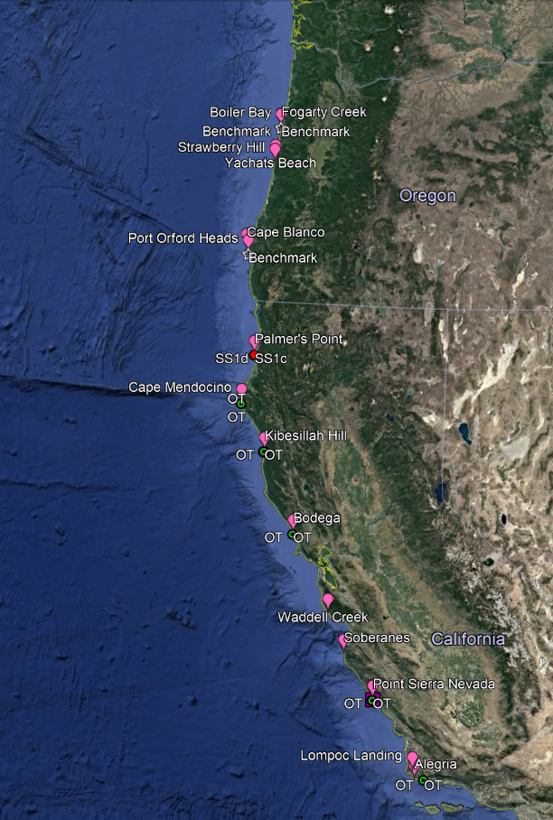
Methods
2 plots, 1 fence, 4 cages per site
OR: Nucella only, Nucella and Leptasterias, Leptasterias only, no preds (control)
CA: Nucella only, no preds (control)
15x15 cm cages deployed ~1m under lower limit of mussel bed
Cleared at experiment start (May 2018)
Stocked w/preds (site specific density) once prey had recruited
OR/NorCal: July 2018
CenCal: September 2018 (low recruitment)
Notes:
Ok so what is the actual structure of this experiment?
Site distribution
Cage inclusion experiment
Treatments

Slide 5

Recruitment plot (cleared ~monthly)
+ Nucella ostrina + Leptasterias
Colonization plot (cleared once)
+ Nucella + Leptasterias
Colonization fence (Cage Control)
+ Nucella + Leptasterias
Nucella only
+ Nucella - Leptasterias
Leptasterias only
- Nucella + Leptasterias
Both predators
+ Nucella + Leptasterias
Predator exclusion
- Nucella - Leptasterias
OR only
OR only
Notes:
To review; here’s a visual depiction of the experimental schematic I just described.

Slide 6
Overarching goal
Build a Structural Equation Model (SEM) – multivariate method that facilitates investigation of direct and indirect interactions
Investigate mechanisms behind variation in interaction strengths across a wide biogeographic gradient
Increasing understanding of mechanisms shaping community structure -> increased predictive capacity re: community-level response to climate change
Notes:
Might be able to construct a structural equation model using experiment-derived predation strength variables (i.e. response variable is community structure or presence/absence of mussels, explanatory variables are Nucella presence, Lepta presence)
Multivariate method (like PCA, NMS) that allows us to ask questions about interactions
1,260 OR photos (6 timepoints, 1/season) + 1,050 CA photos= 2300 photos total

Slide 7
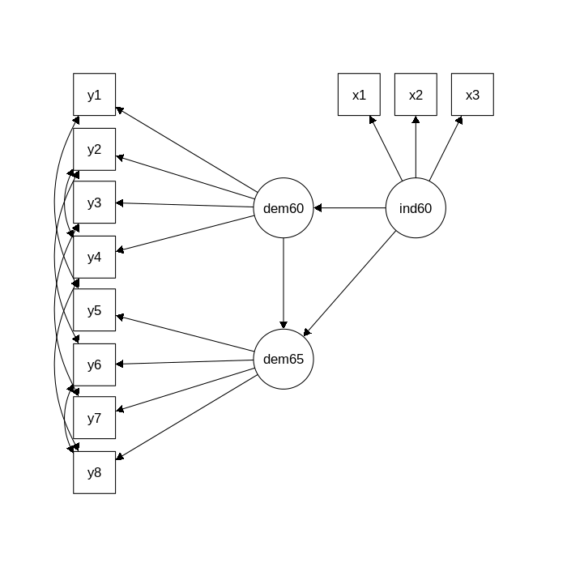
Products of this class
Generate workflow for vignette in R package lavaan
Build SEM with this dataset, learn how to use package
Draw model for my experiment (theoretical framework)
Notes:
Built in example from the r package lavaan, which I’ll be using to model
This is a dataset that has been used by Bollen in his 1989 book on structural equation modeling (and elsewhere). “industrialization and political democracy”
Walks ya through generating the beautiful SEM on the right
A data frame of 75 observations of 11 variables.
Y1 Expert ratings of the freedom of the press in 1960
Y2 The freedom of political opposition in 1960
Y3 The fairness of elections in 1960
Y4 The effectiveness of the elected legislature in 1960
Y5 Expert ratings of the freedom of the press in 1965
Y6 The freedom of political opposition in 1965
Y7 The fairness of elections in 1965
Y8 The effectiveness of the elected legislature in 1965
X1 The gross national product (GNP) per capita in 1960
X2 The inanimate energy consumption per capita in 1960
X3 The percentage of the labor force in industry in 1960

Slide 8
Desired end result
Workflow for example previously described
Drawn version of my actual model
Goal is to have a flexible workflow that I can modify to run my data once I have it

Slide 9
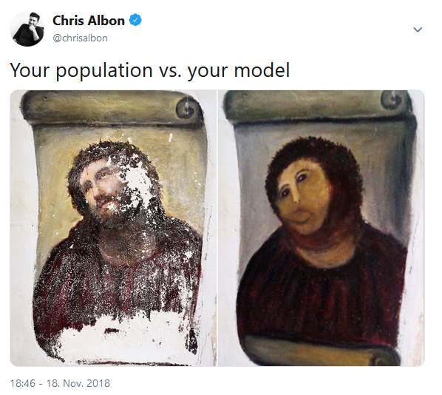
Stretch goal
Developing a theoretical SEM that’s good enough to simulate data
Can use to assess predictive capacity of the model once I have fit it to my actual data + ground truth mechanisms
Notes:
Ben: can I use the model I build to generate data (with noise) that, when you fit a new model to it, match the R² of my original model?
Ben: stuff of double impact factor journals

Slide 10
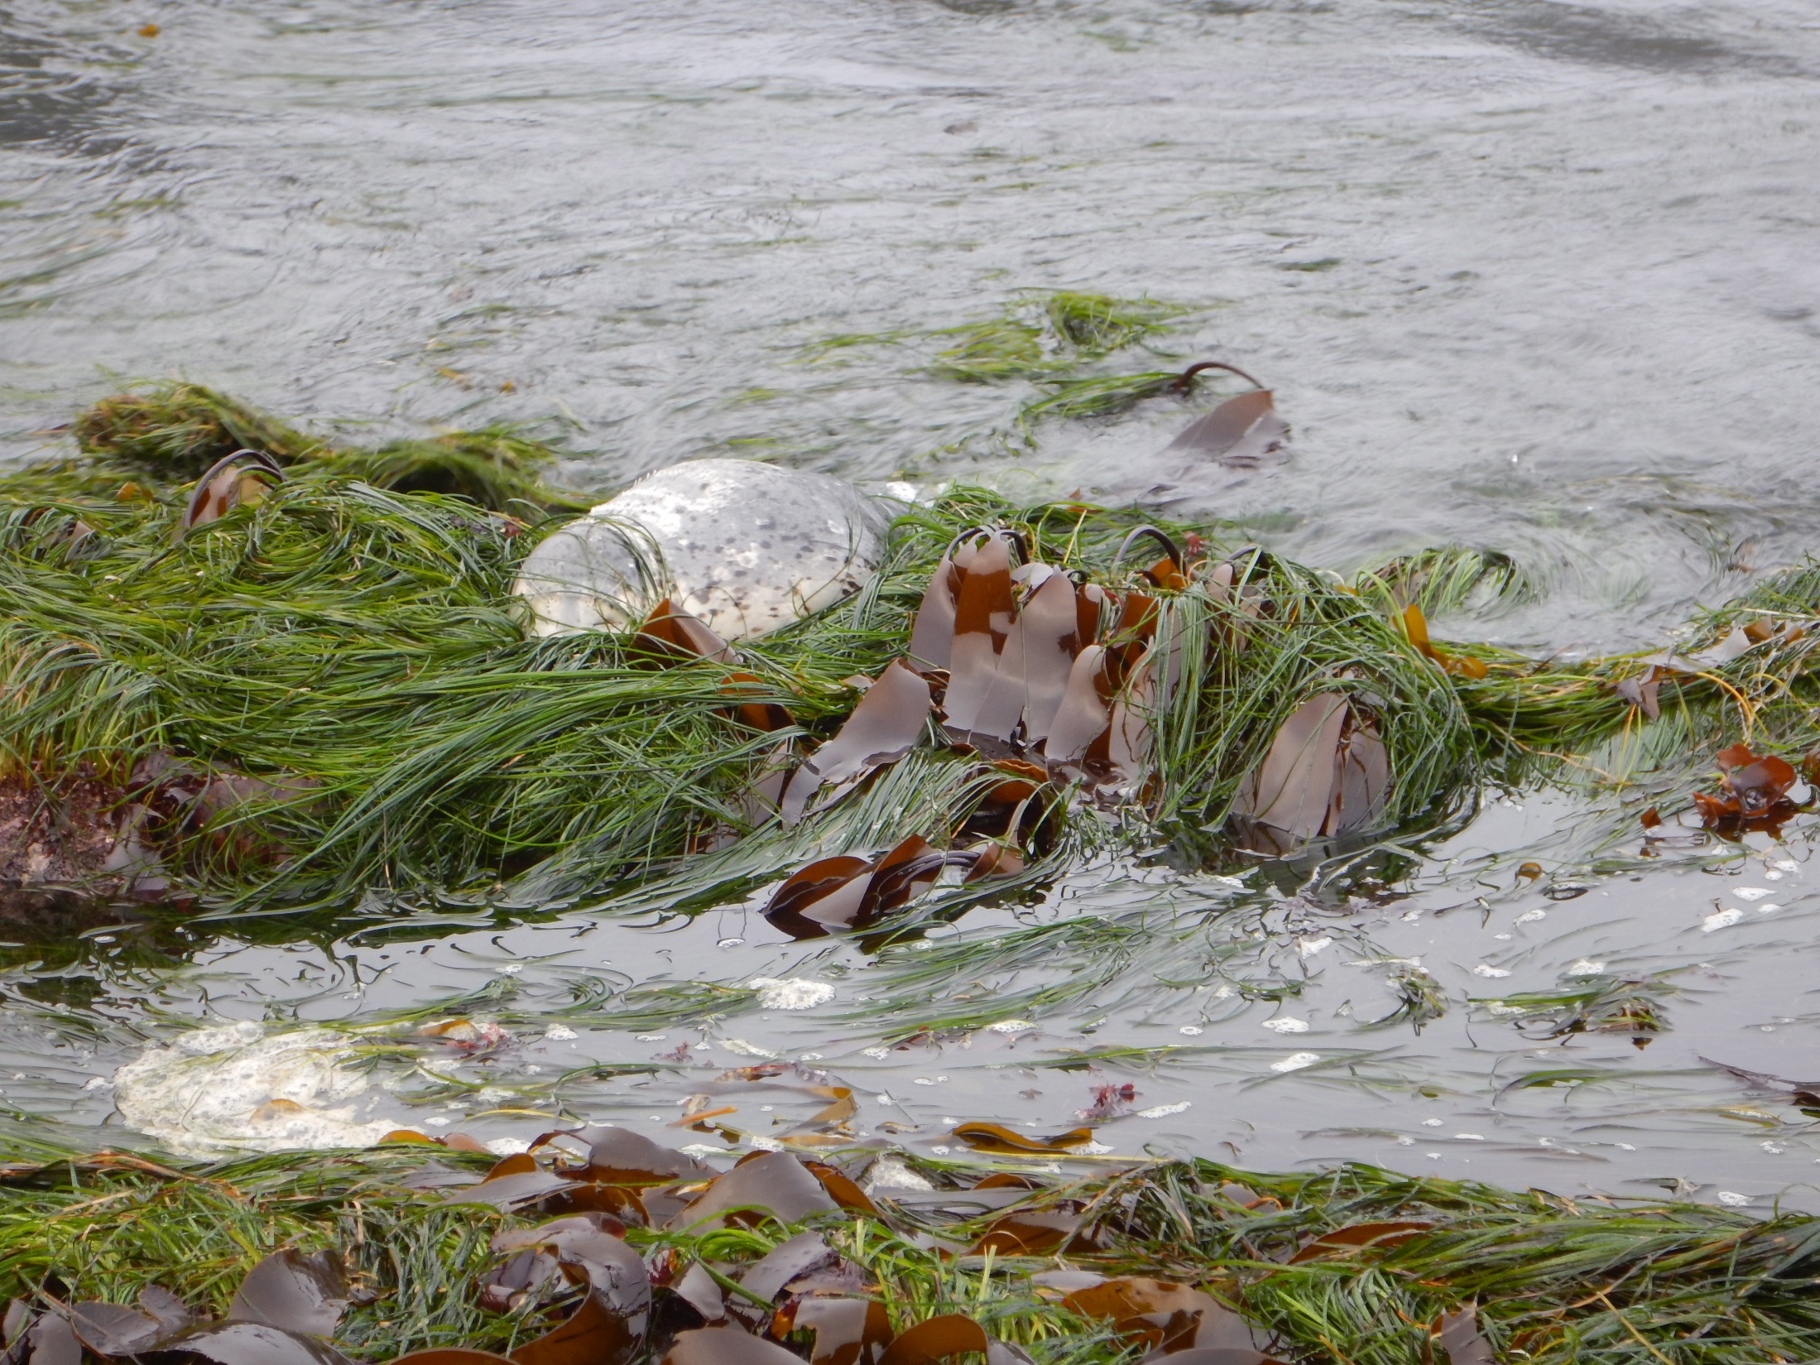
Questions?

Slide 11
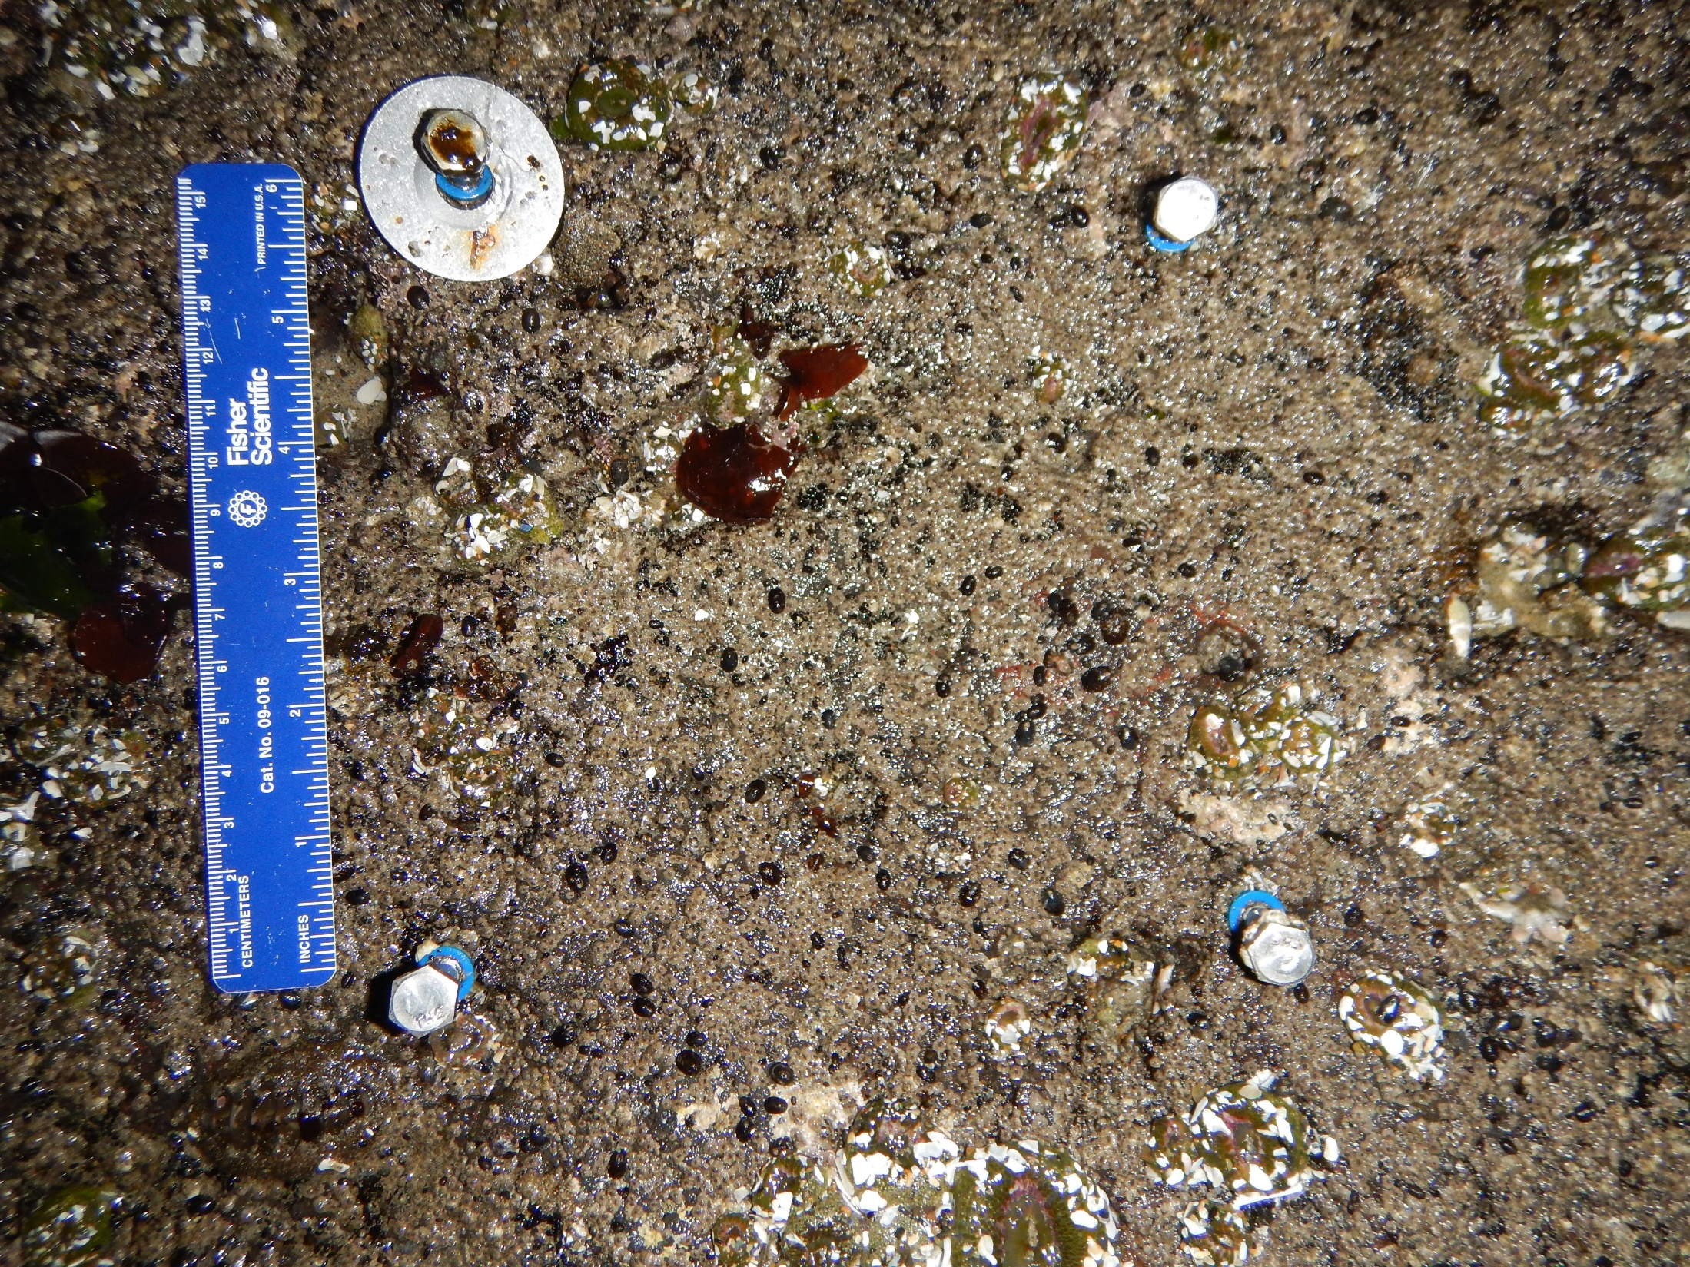
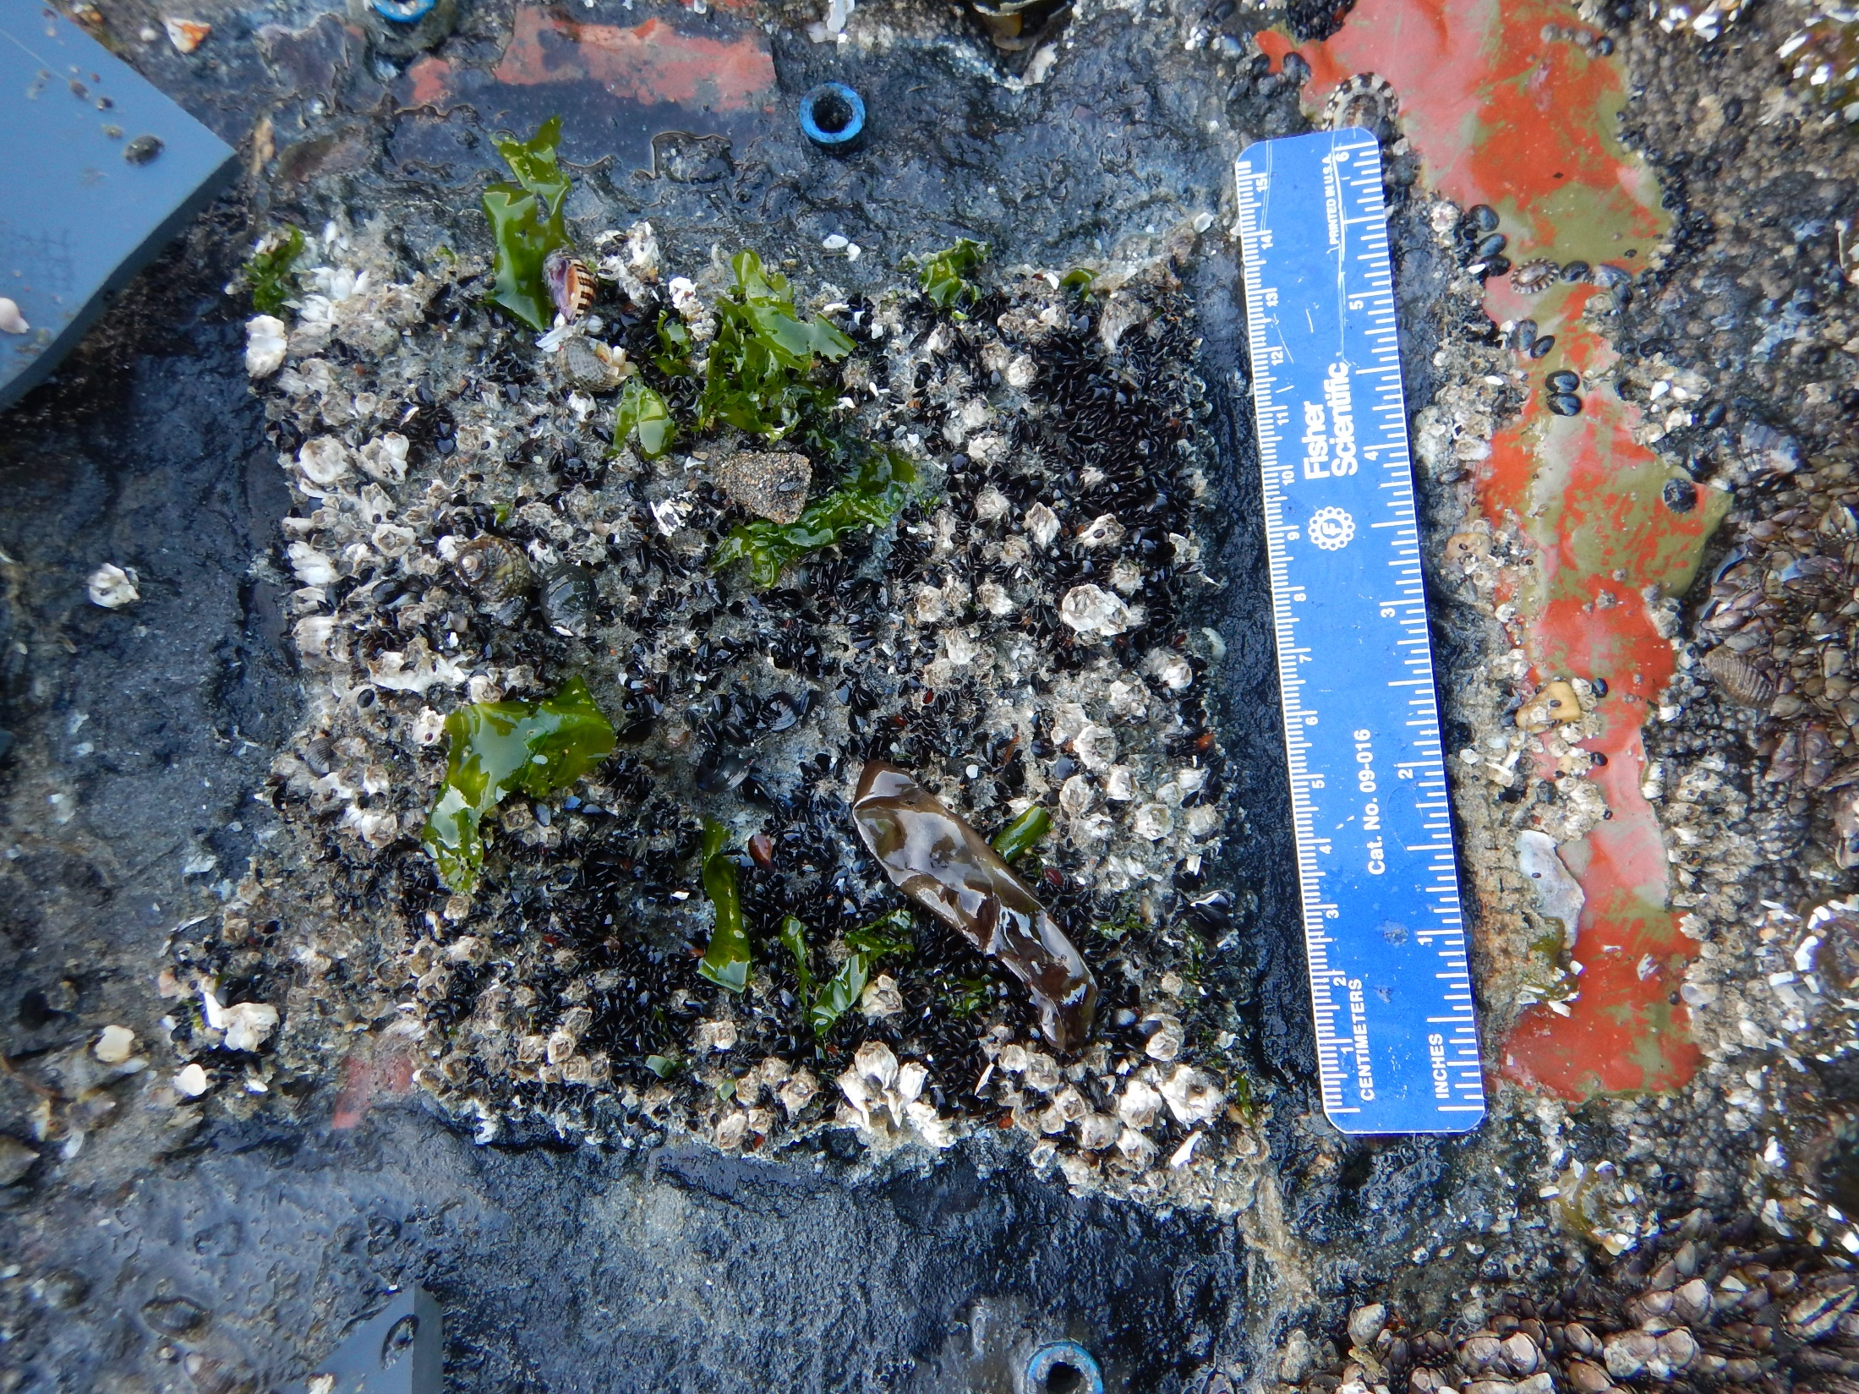
Notes:
Photo of plots
Left: example of a colonization plot from SH (plot2C)- lots of inverts!
No clearing (last cleared May 2018- 4 months previous)
Lots of limpets/grazers present in plots
Not so much in cages, though some grazers present
Right: example of a cage plot (1NL), so 4 Nucella ostrina and 1 Leptasterias live here
Gives an idea of what these little communities can look like!

Slide 12
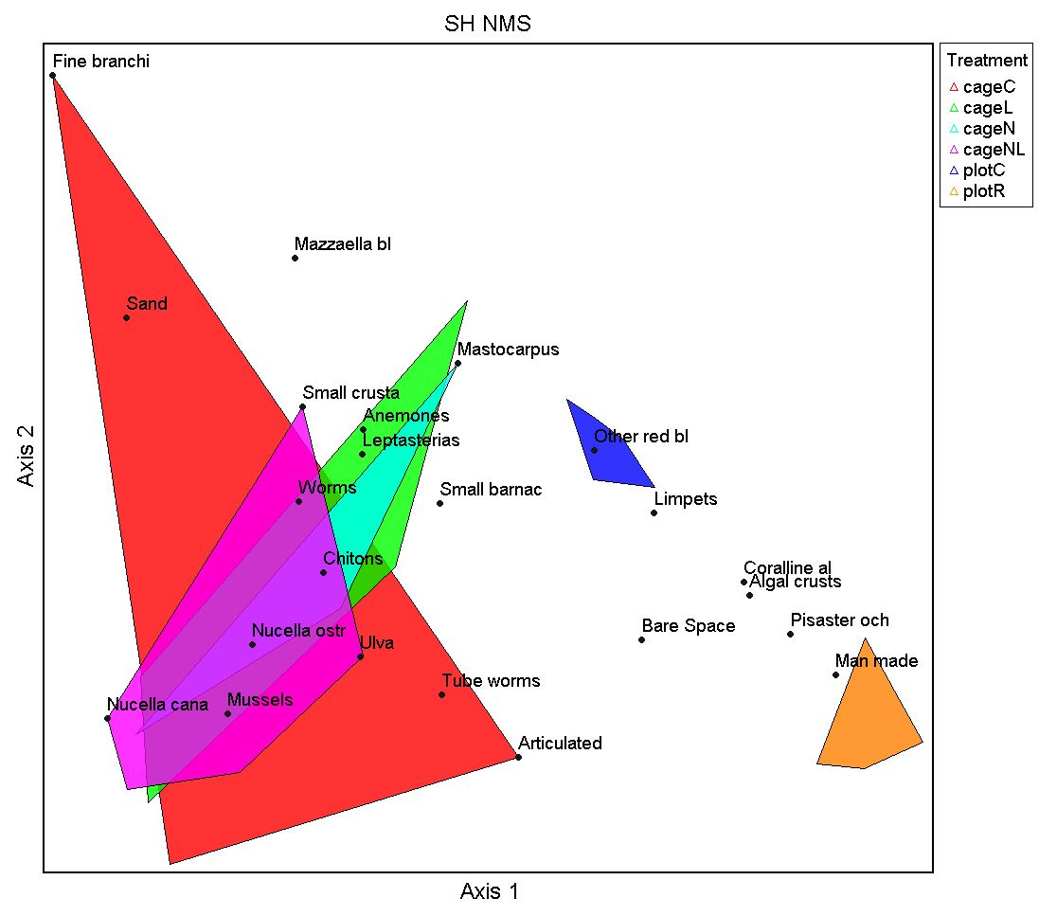
Notes:
Nonmetric multidimensional scaling
NMS- 2D solution recommended, Sorensen distance
8.73261 = final stress for 2-dimensional solution
0.00030 = final instability
R²n (nonmetric fit) = 0.9924
Plots grouped by treatment (makes sense, pretty drastic)
When we include all the species, variability is still present-overlap between treatments
Lots of things could cause this (lack of visible signal in treatment data) including predator incursion, time- are they at different successional stages?

Slide 13
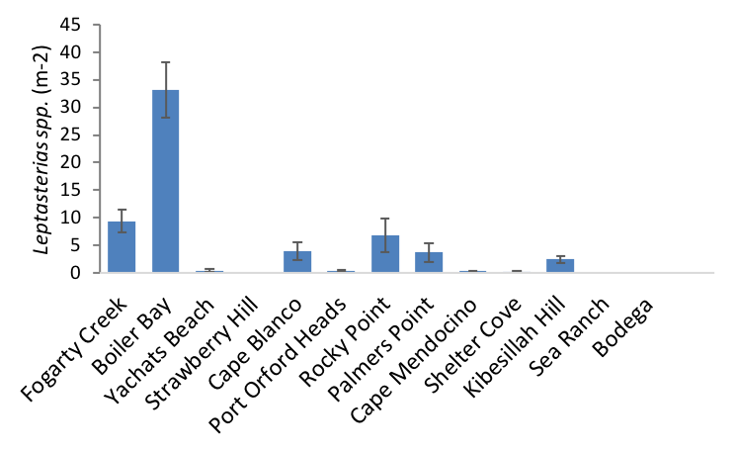
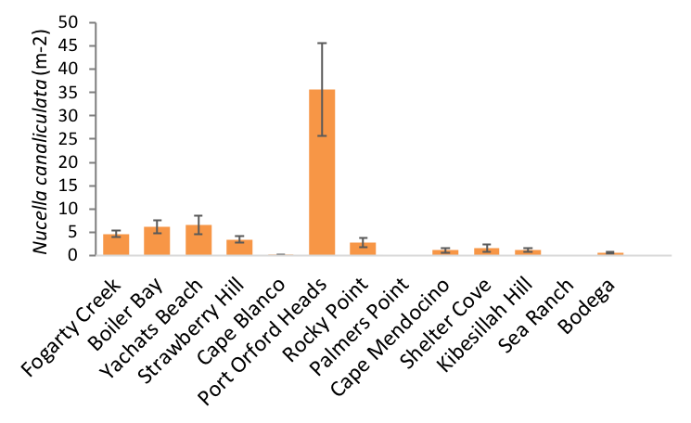
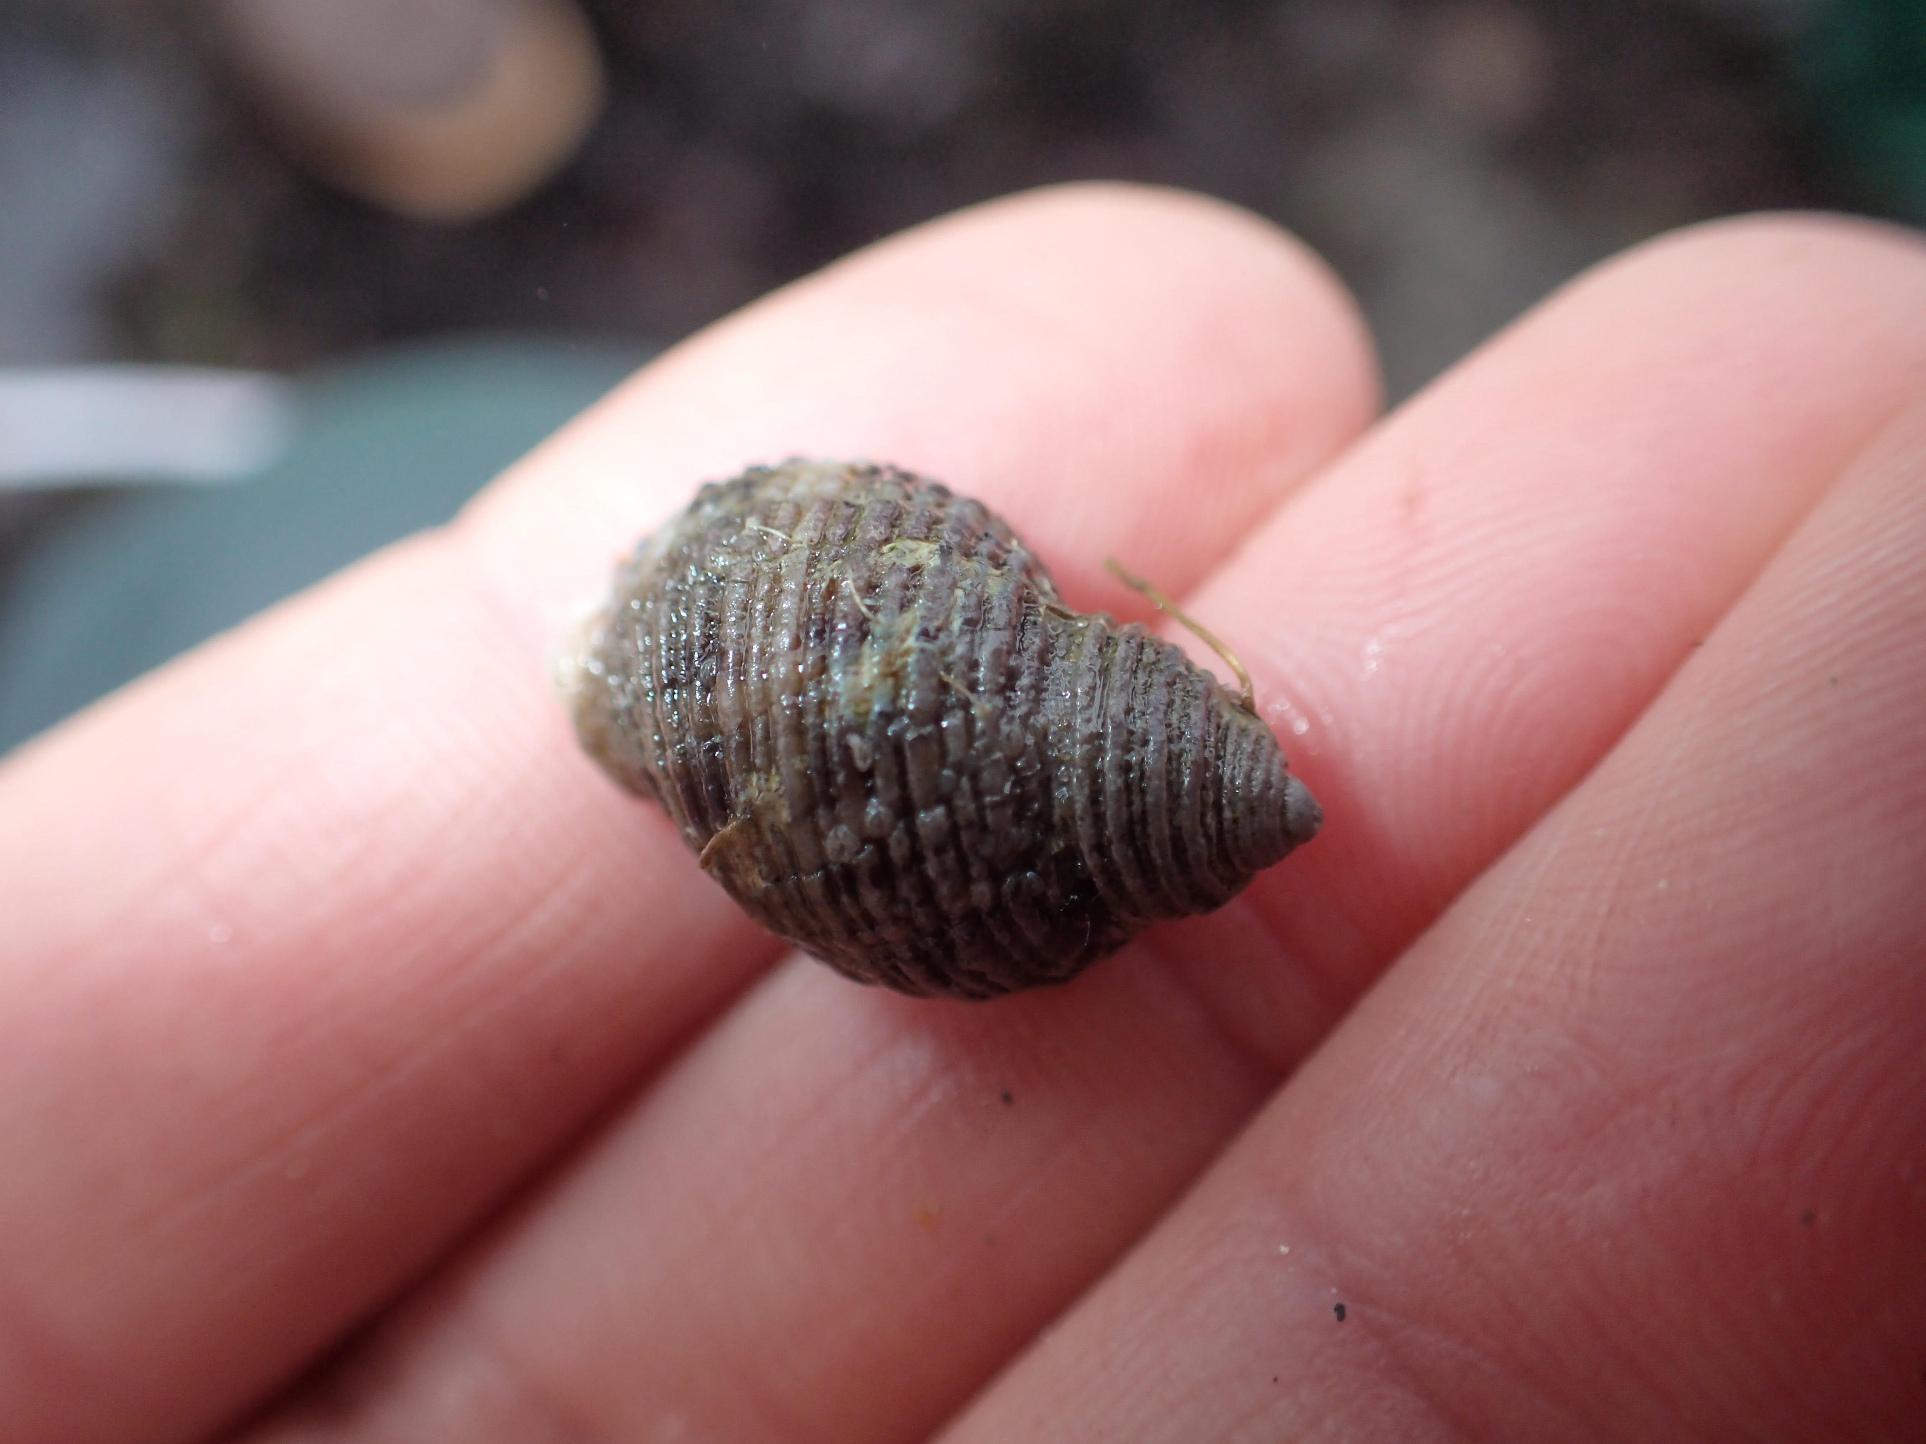
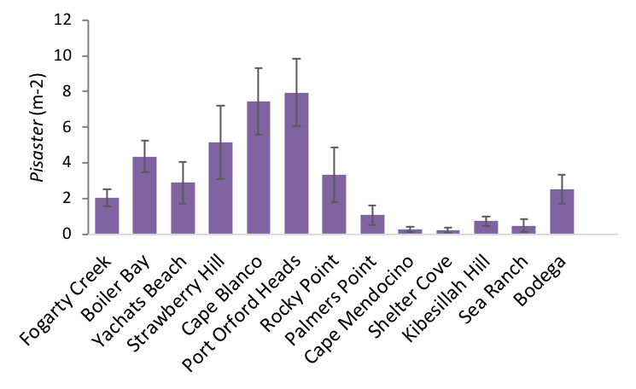
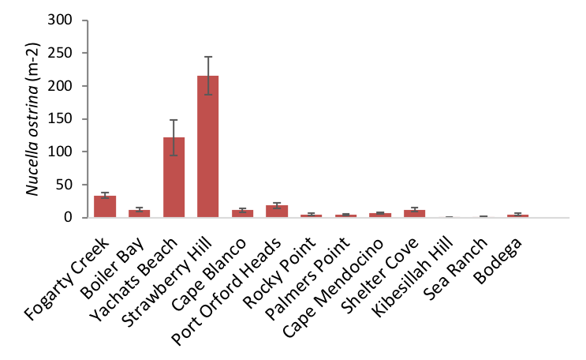
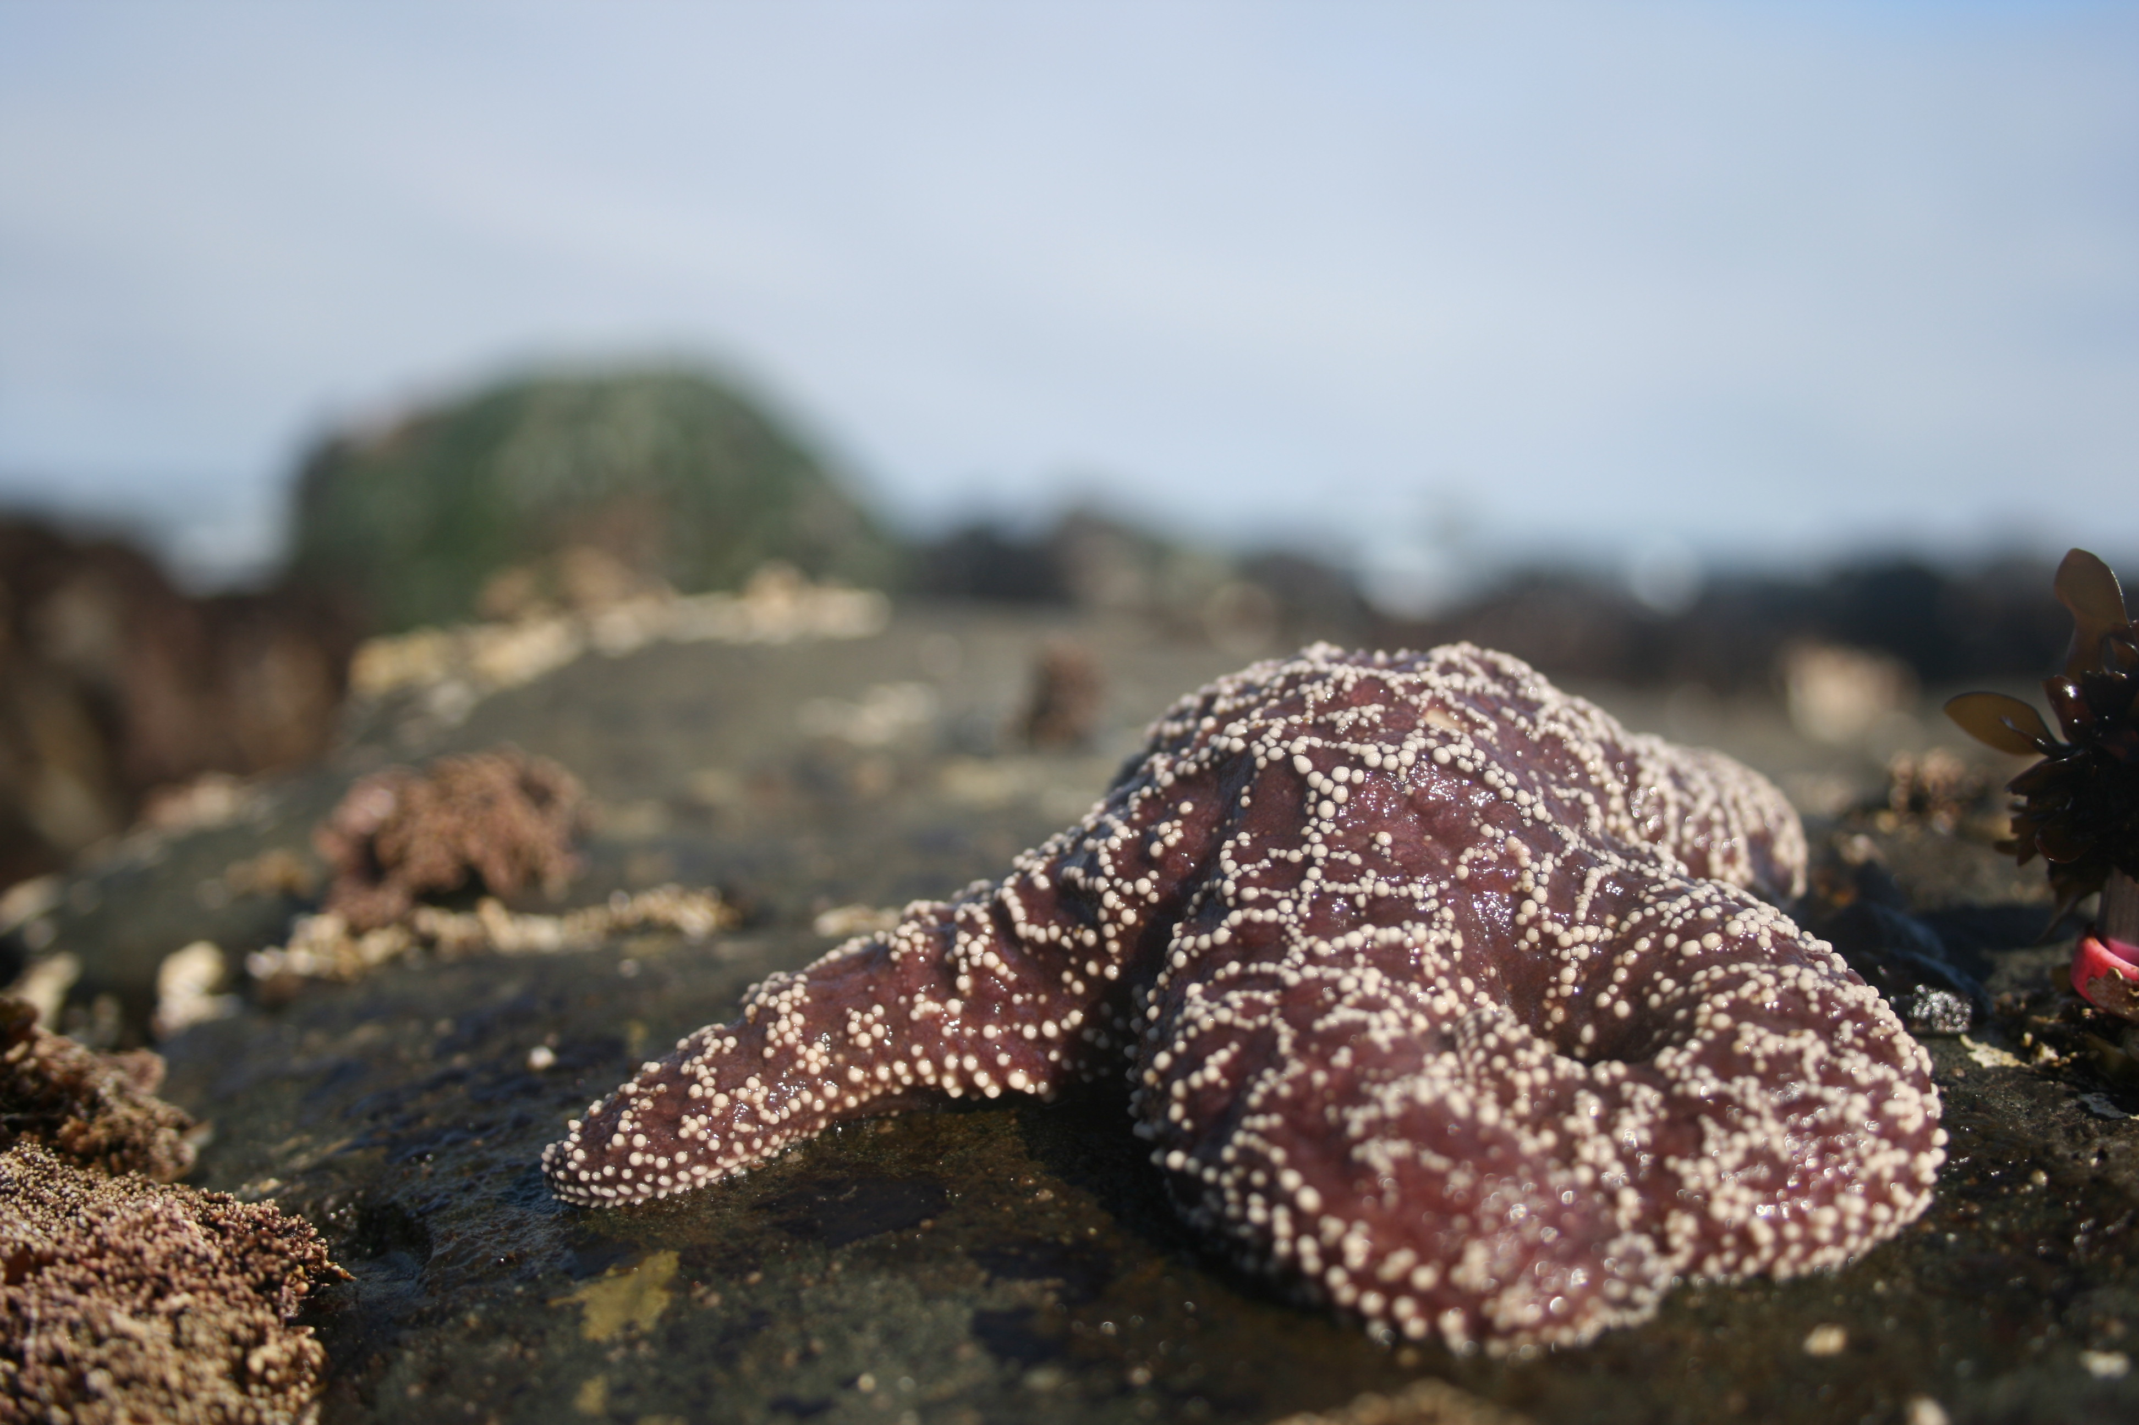
Predator Densities
Density X Lat:
P = 0.062
R² = 0.282
Density X Lat:
P = .018
R² = 0.362
Density X Lat:
P = 0.029
R² = .018
Density X Lat:
P = 0.004
R² = 0.004
Notes:
Data from Sarah Gravem, Amanda Chiachi
Explain Fig: x axis we have sites, and y axis we have density of each predator per meter^2
OR/CA break
Analyzed by latitude and found that densities ARE consistently higher in Oregon and California
Consistent among species
However, predators in CA are larger than in OR… (SKIP UNLESS ASKED)

Slide 14
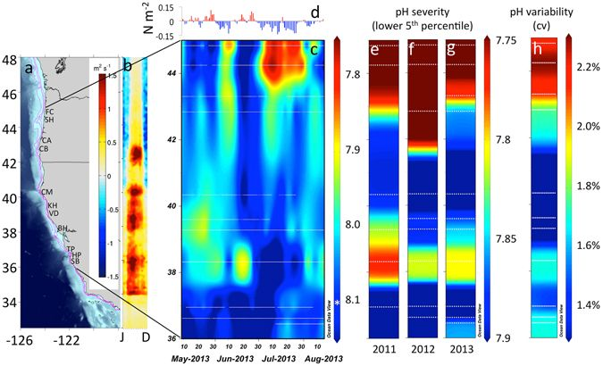
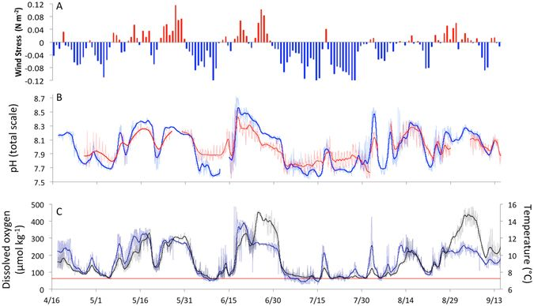
The system is both spatially variable
…and temporally variable
Chan et. al. 2017 Sci Reports
Notes:
Upwelling strength variation from CA to OR, variation in wind, pH, DO (at SH), temp from April-September 2013
Foulweather- lower upwelling
Perpetua, Blanco, Mendo- higher upwelling
Left fig
Intertidal pH_{total} variation across the CCLME study domain of contrasting shelf topography as delineated by the 75 m, 100 m, 200 m isobaths (magenta), and (b) wind-driven cross-shelf surface transport (m² s⁻¹)(see scale inset in a). Map was generated from the ETOPO1 dataset⁴² in Matlab v8.2 (http://www.mathworks.com/products/matlab). (c) Variation in pH at the event-scale during part of the 2013 upwelling season with asterisk denoting global mean surface pH¹² and (d) accompanying daily wind stress (N m⁻²) at 44.65°N, (e–g) severity of low pH exposure (lower 5th percentile) across three years of deployment and (h) pH variability. White dotted lines in pH panels denote station locations.
Right fig
(a) 2013 wind forcing as indexed by along-shore wind stress at 44.65N, (b) intertidal pH (red) and inner-shelf pH (blue) at 44.25°N, (c) temperature (black) and dissolved oxygen (blue) from moorings deployed directly offshore (15 m water depth). Red line in (c) denotes hypoxia threshold of 65 μmol kg⁻¹. Bold lines in (b,c) denote low-pass filtered (40 h window LOESS filter) time-series.
From Chan et al 2017 Scientific reports Persistent spatial structuring of coastal ocean acidification in the California Current System

